Slide 1


SMART HOME
Team Valeo

Slide 2
Team Members
Mohamed Mamdouh
Mohamed Gamal
Abdelrahman El-sayed
Adham Salah

Slide 3
Agenda
FEATURES
01
Block DIAGRAM
02
CODE REVIEW
03

Slide 4
Features
Security system
Lightning control
Garage system
Temperature control
Weather control

Slide 5
Block Diagram
EEPROM
KEYPAD
STEPPER
MOTOR
“Garage Gate”
LCD
DC MOTOR
“Fan”
MCU 1
MCU 2
LCD
UART
LM 35
DHT 22
SERVO
“Door”
IR
ULTRASONIC
LED
LDR

Slide 6
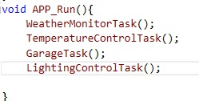
Code Review

